Slide 1
WELCOME COLBY SCHOOL DISTRICT
Stakeholder Driven Strategic Planning
January 8, 2014

Slide 2
Agenda for this evening..
January 8, 2014 @ 6:00 PM Middle School LMC
Introductions (10)
Introduce Al Brown
Introductions FOR Al to get to know you
Where we have been? (5-7) Steve
Where we will be going in our final two meetings? (10-15) Al
Al will update strategic planning process and share the next steps in this process.
Results Data (20) Steve
Community Survey
Internal Survey (leadership) results (to date - 14 of 20)
Prior Strategic Planning notes
SOAR Analysis
Thematic Analysis Activity (60) Al
Next meeting outcomes / Work to be done prior to next meeting/ Process Feedback form- (10)
February 19th

Slide 3
The Mission of the School District of Colby is
Learning for ALL.

Slide 4
Introductions
Please Introduce yourself for Al… briefly simply share your connection to the Colby School District..

Slide 5
Steve Kolden
Where have we been?
Data and Information Reviews
Multiple SOAR activities
SOAR prioritization activity
Community Survey
Internal Leadership Survey (as available)

Slide 6
Al Brown
What’s next and where are we going?

Slide 7
2001-02 Strategic Planning
Develop better communication among school, parents and community.
Establish “quality education” as a #1 community commitment.
Increase the commitment of time and money to develop quality and capacity through staff development initiatives.
Develop a process to ensure that the community retains its most competent board members, district administrative staff, building administrators, teachers, coaches and support staff.
Develop and infrastructure to create comprehensive curricula to include: integration, student choice, basic reading, writing, and mathematics skills, critical thinking skills and assessment methods that include alternatives to grades.
Develop opportunities for students to practice, express and participate in democratic school governance process and, as a result, effect change.

Slide 8
SOAR Activity
Strengths
Opportunities
Aspirations (goals, hopes, dreams)
Results

Slide 9
SOAR Activity
STRENGTHS
Programs- distance learning, ELL study club, music, FFA, Community Ed, interventions for struggling students, AP classes (9)
Closing achievement gaps, graduation rate (8)
Facilities (9)
Extra-curriculars- sports, music, choir, band (7)
Staff (6)
Infrastructure (5) ??
Community support (3)
PLC (2)
District website
Tech committee

Slide 10
SOAR Activity
OPPORTUNITIES
Technology for all staff and students, including devices and internet at home, school; technology plan; use community resources (8)
Work more with other districts, collaborate with other districts - school consolidation, cooperation (6)
Obtain more grants (3)
Distance learning (3)
Hands on learning (3)
Outside business working with students (3)
ELL Support (2)
Increased parental involvement (2)
Little Stars (2)
RTI (2)

Slide 11
SOAR Activity
OPPORTUNITIES - continued
Extra-curriculuars
Attract open-enrollment money
Improve attendance
Teach students to think
District center building - CDEC
Market school website
Course offerings
After school programs; after school programs for struggling students (3)
Develop survey (optional) for parents to send their child(ren) to another district
More opportunity for students
Basic life skills classes
All AP classes blended or online
Use of Red House and District Center Building

Slide 12
SOAR Activity
ASPIRATIONS
Technology- more technology, 1:1, distance learning (10)
Close open-enrollment gap (7)
Improve student achievement (5)
Better relationships with parents (5)
Retain quality staff (4)
Teaching students basics, basic life skills, how to think (4)
More ELL support (2)
Improve Little Stars (2)
School consolidation- coop programs (2)
Control costs
Retain quality graduates
Change the funding formula
New materials to cover CCSS
More space at schools

Slide 13
SOAR Activity
RESULTS
Increase student achievement, close gaps (16)
Better opportunities for students (students ready for the real world, ready for higher education) (9)
Improve technology, technology plan (7)
Improve staff morale, greater student satisfaction (4)
Co-operate, consolidate (4)
Better use of CDEC, District Office (3)
Teach kids to think (2)
Programs to meet needs (2)
Overall higher quality district
District demographics, income improves
Open enrollment decreasing
Little Stars, facilities

Slide 14
Internal Leadership Survey Questions
Stakeholder Driven Strategic Planning
Leadership Survey
Based on the Baldridge Criteria for Performance Excellence
Requested to complete (17 of 20);
HS Principal, MS Principal, El Co-Principal, SPED Director, Title I coordinator, Director of Building and Grounds, Director of Food Service, Bookkeeper, Exec. Assistant, 2 HS staff, 2 MS staff,
2 Elem staff, 1 LS staff, 1 Custodial support staff,
1 Food Service support staff, 2 Teacher assistant support

Slide 15
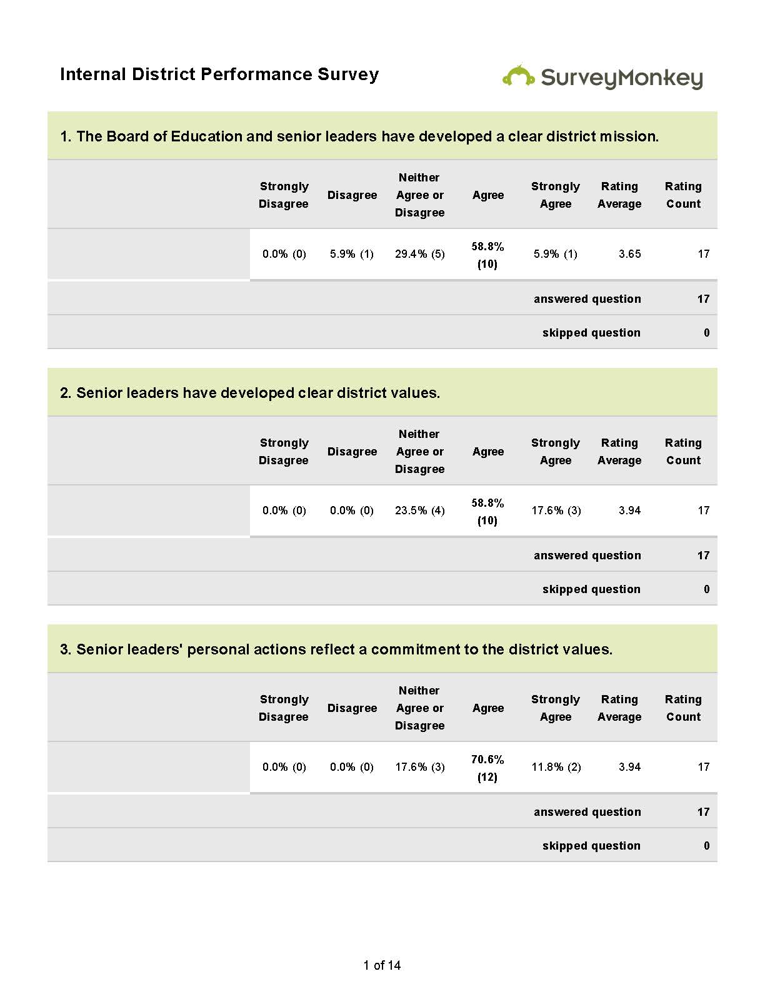

Slide 16
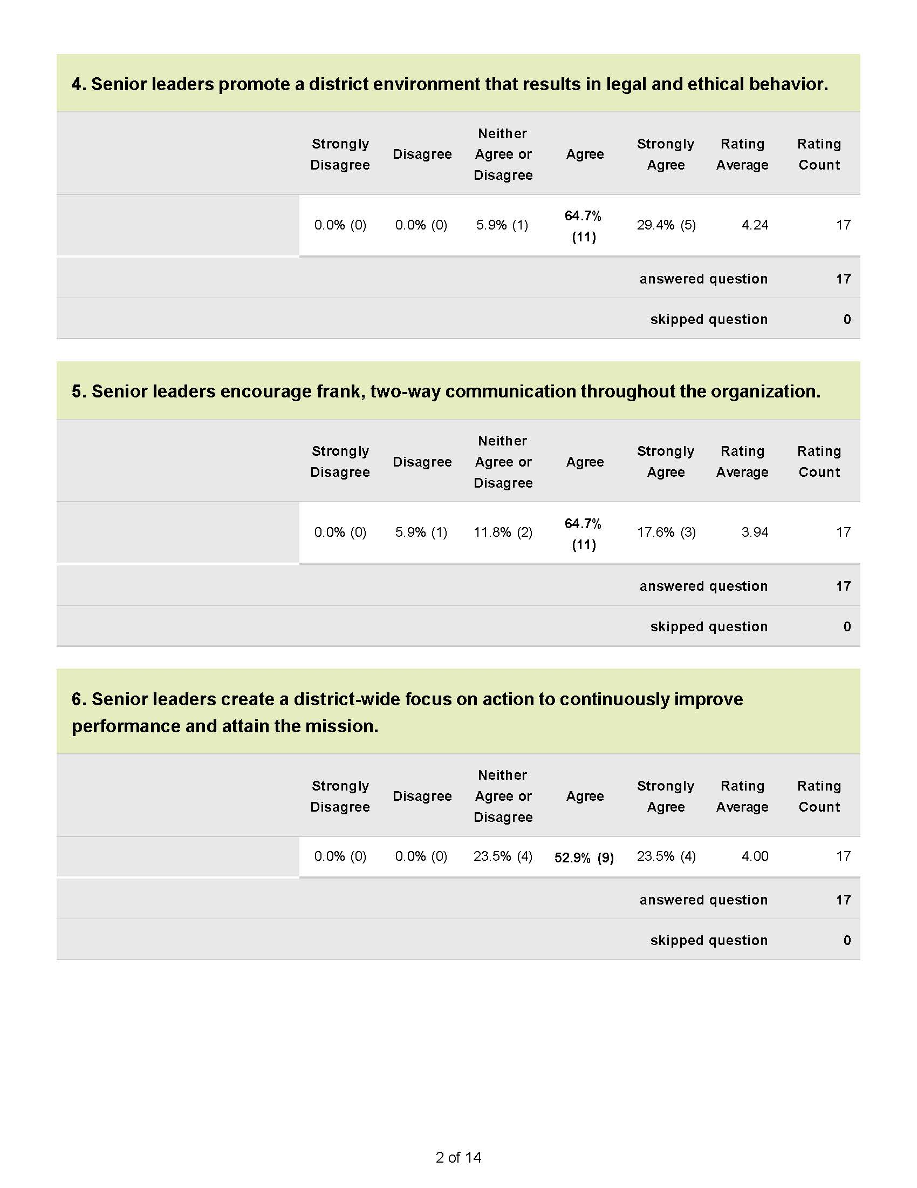

Slide 18
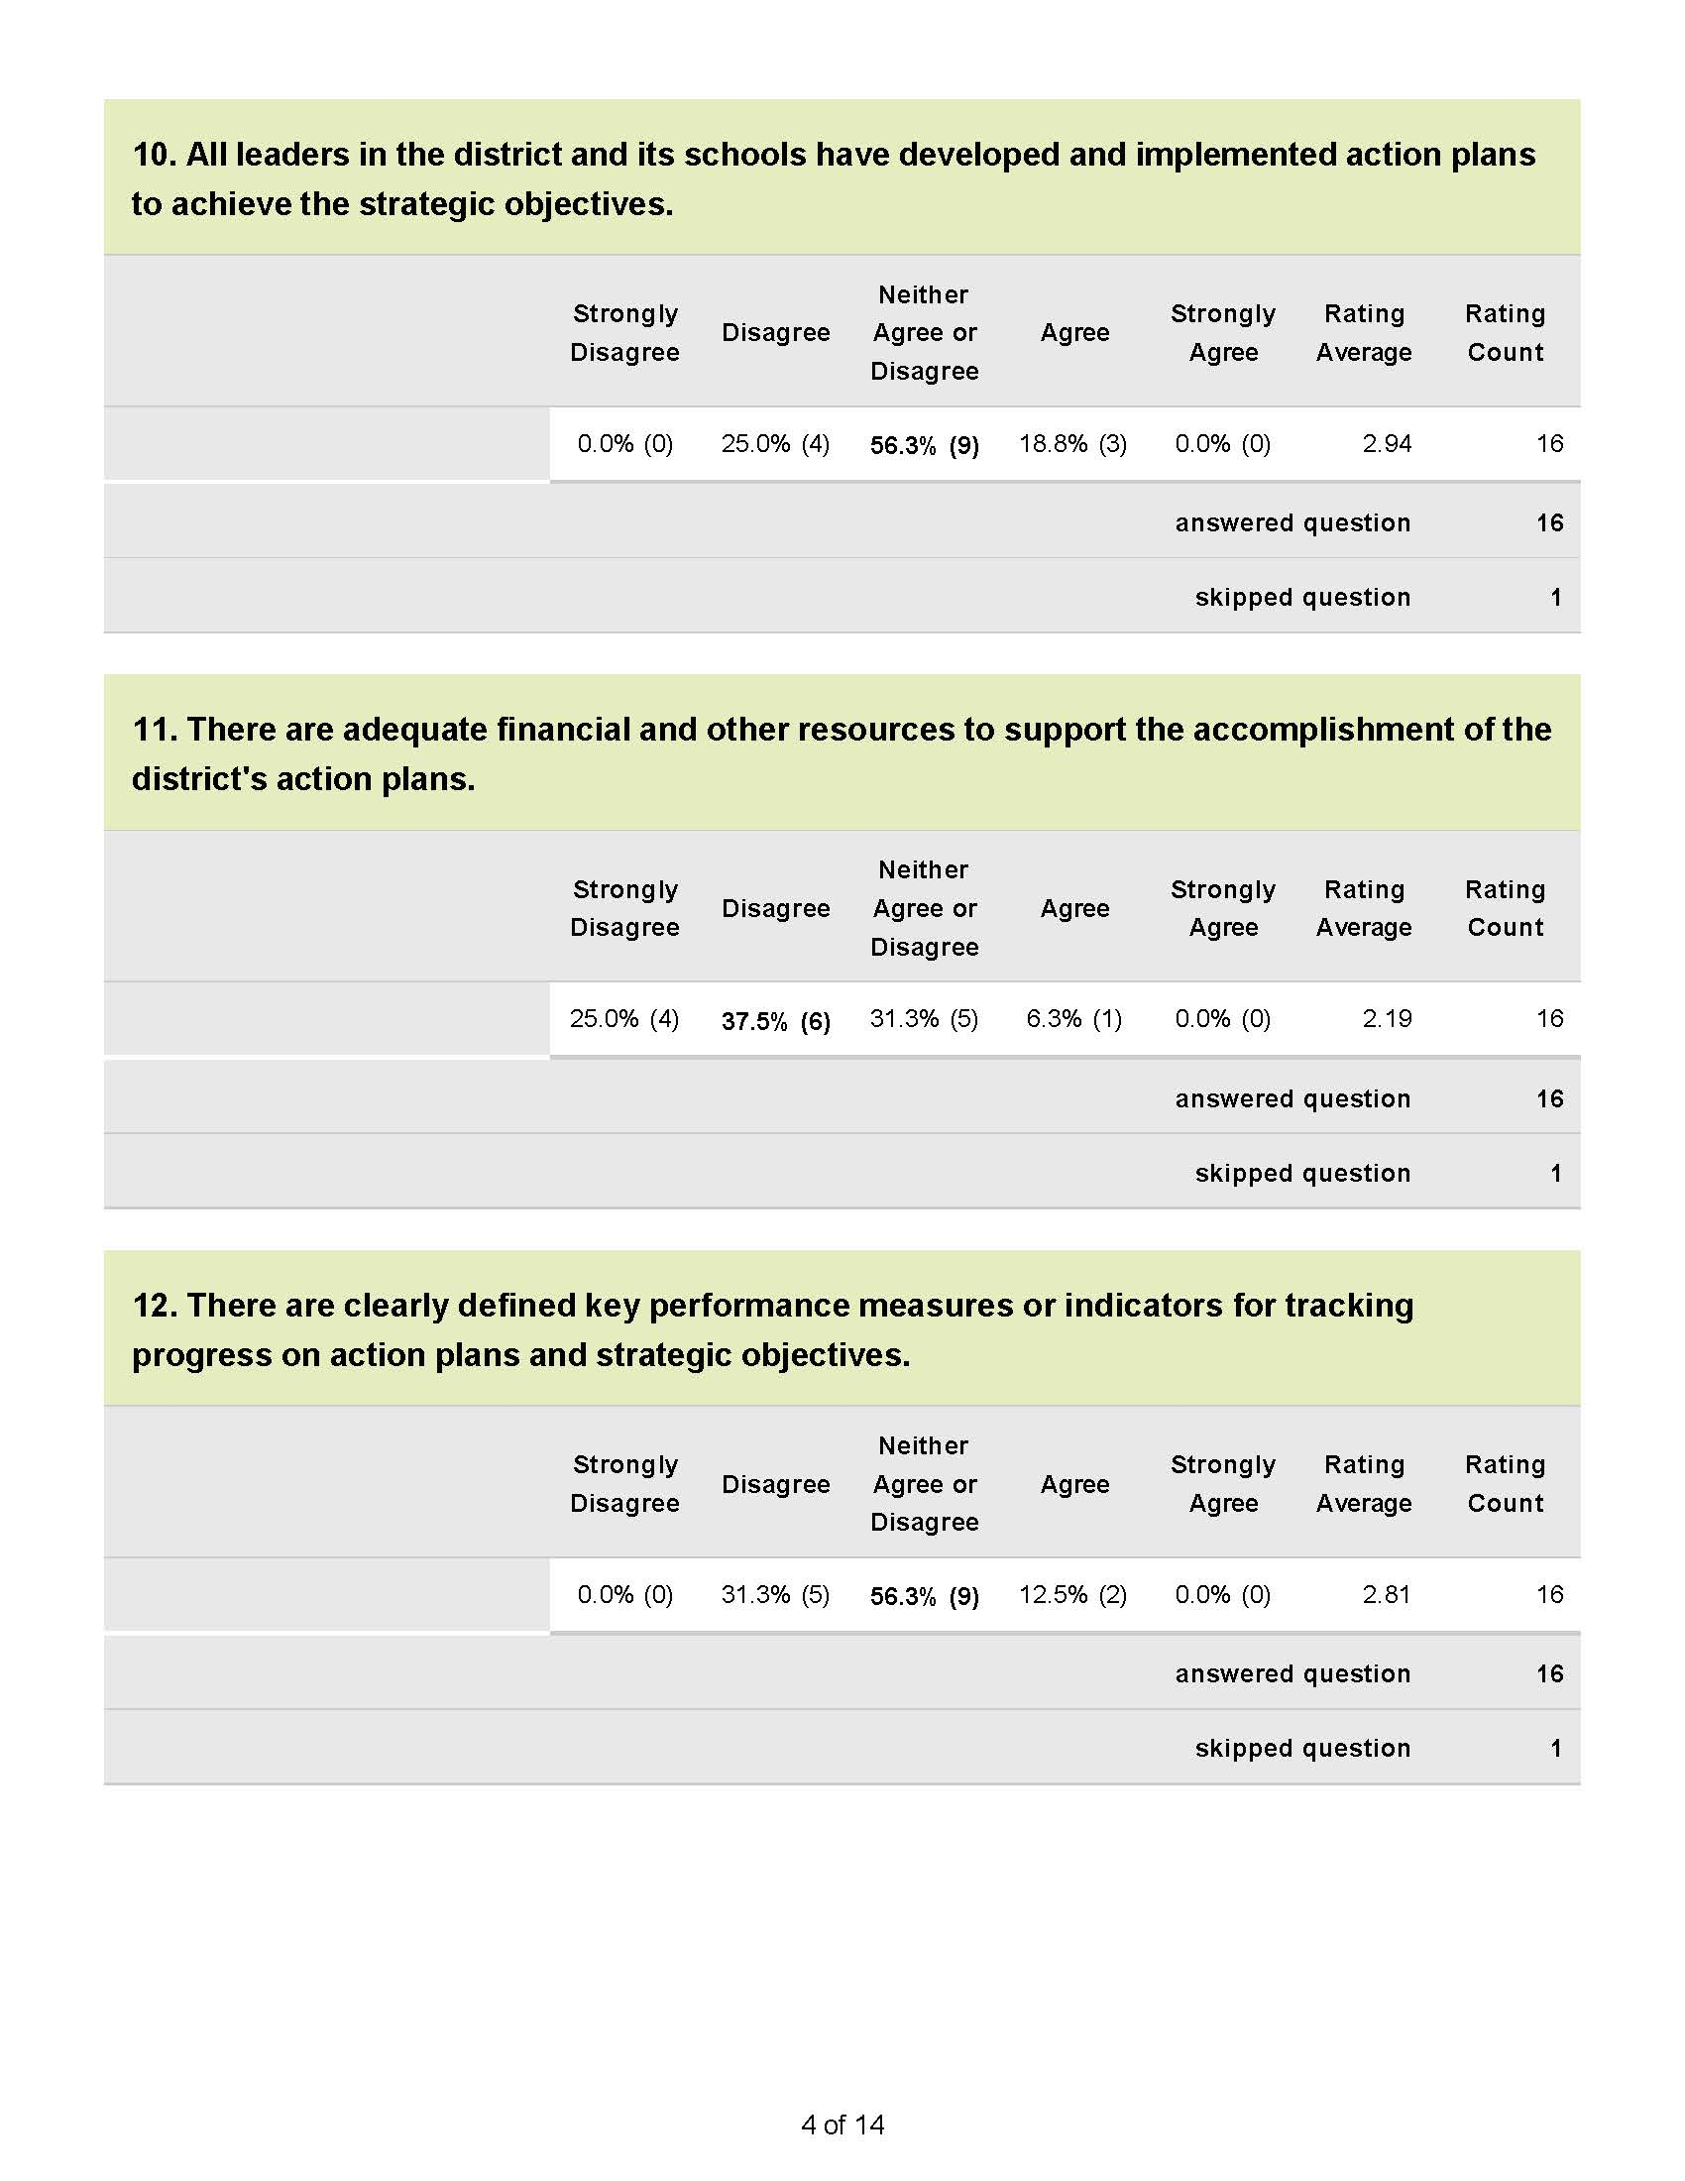

Slide 19
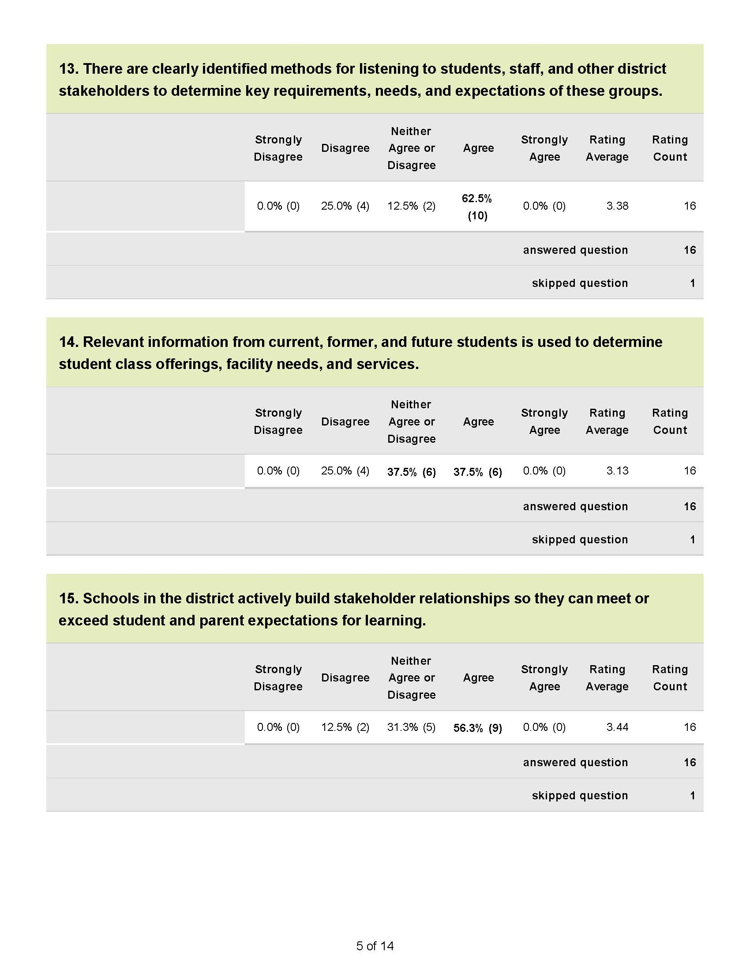

Slide 20
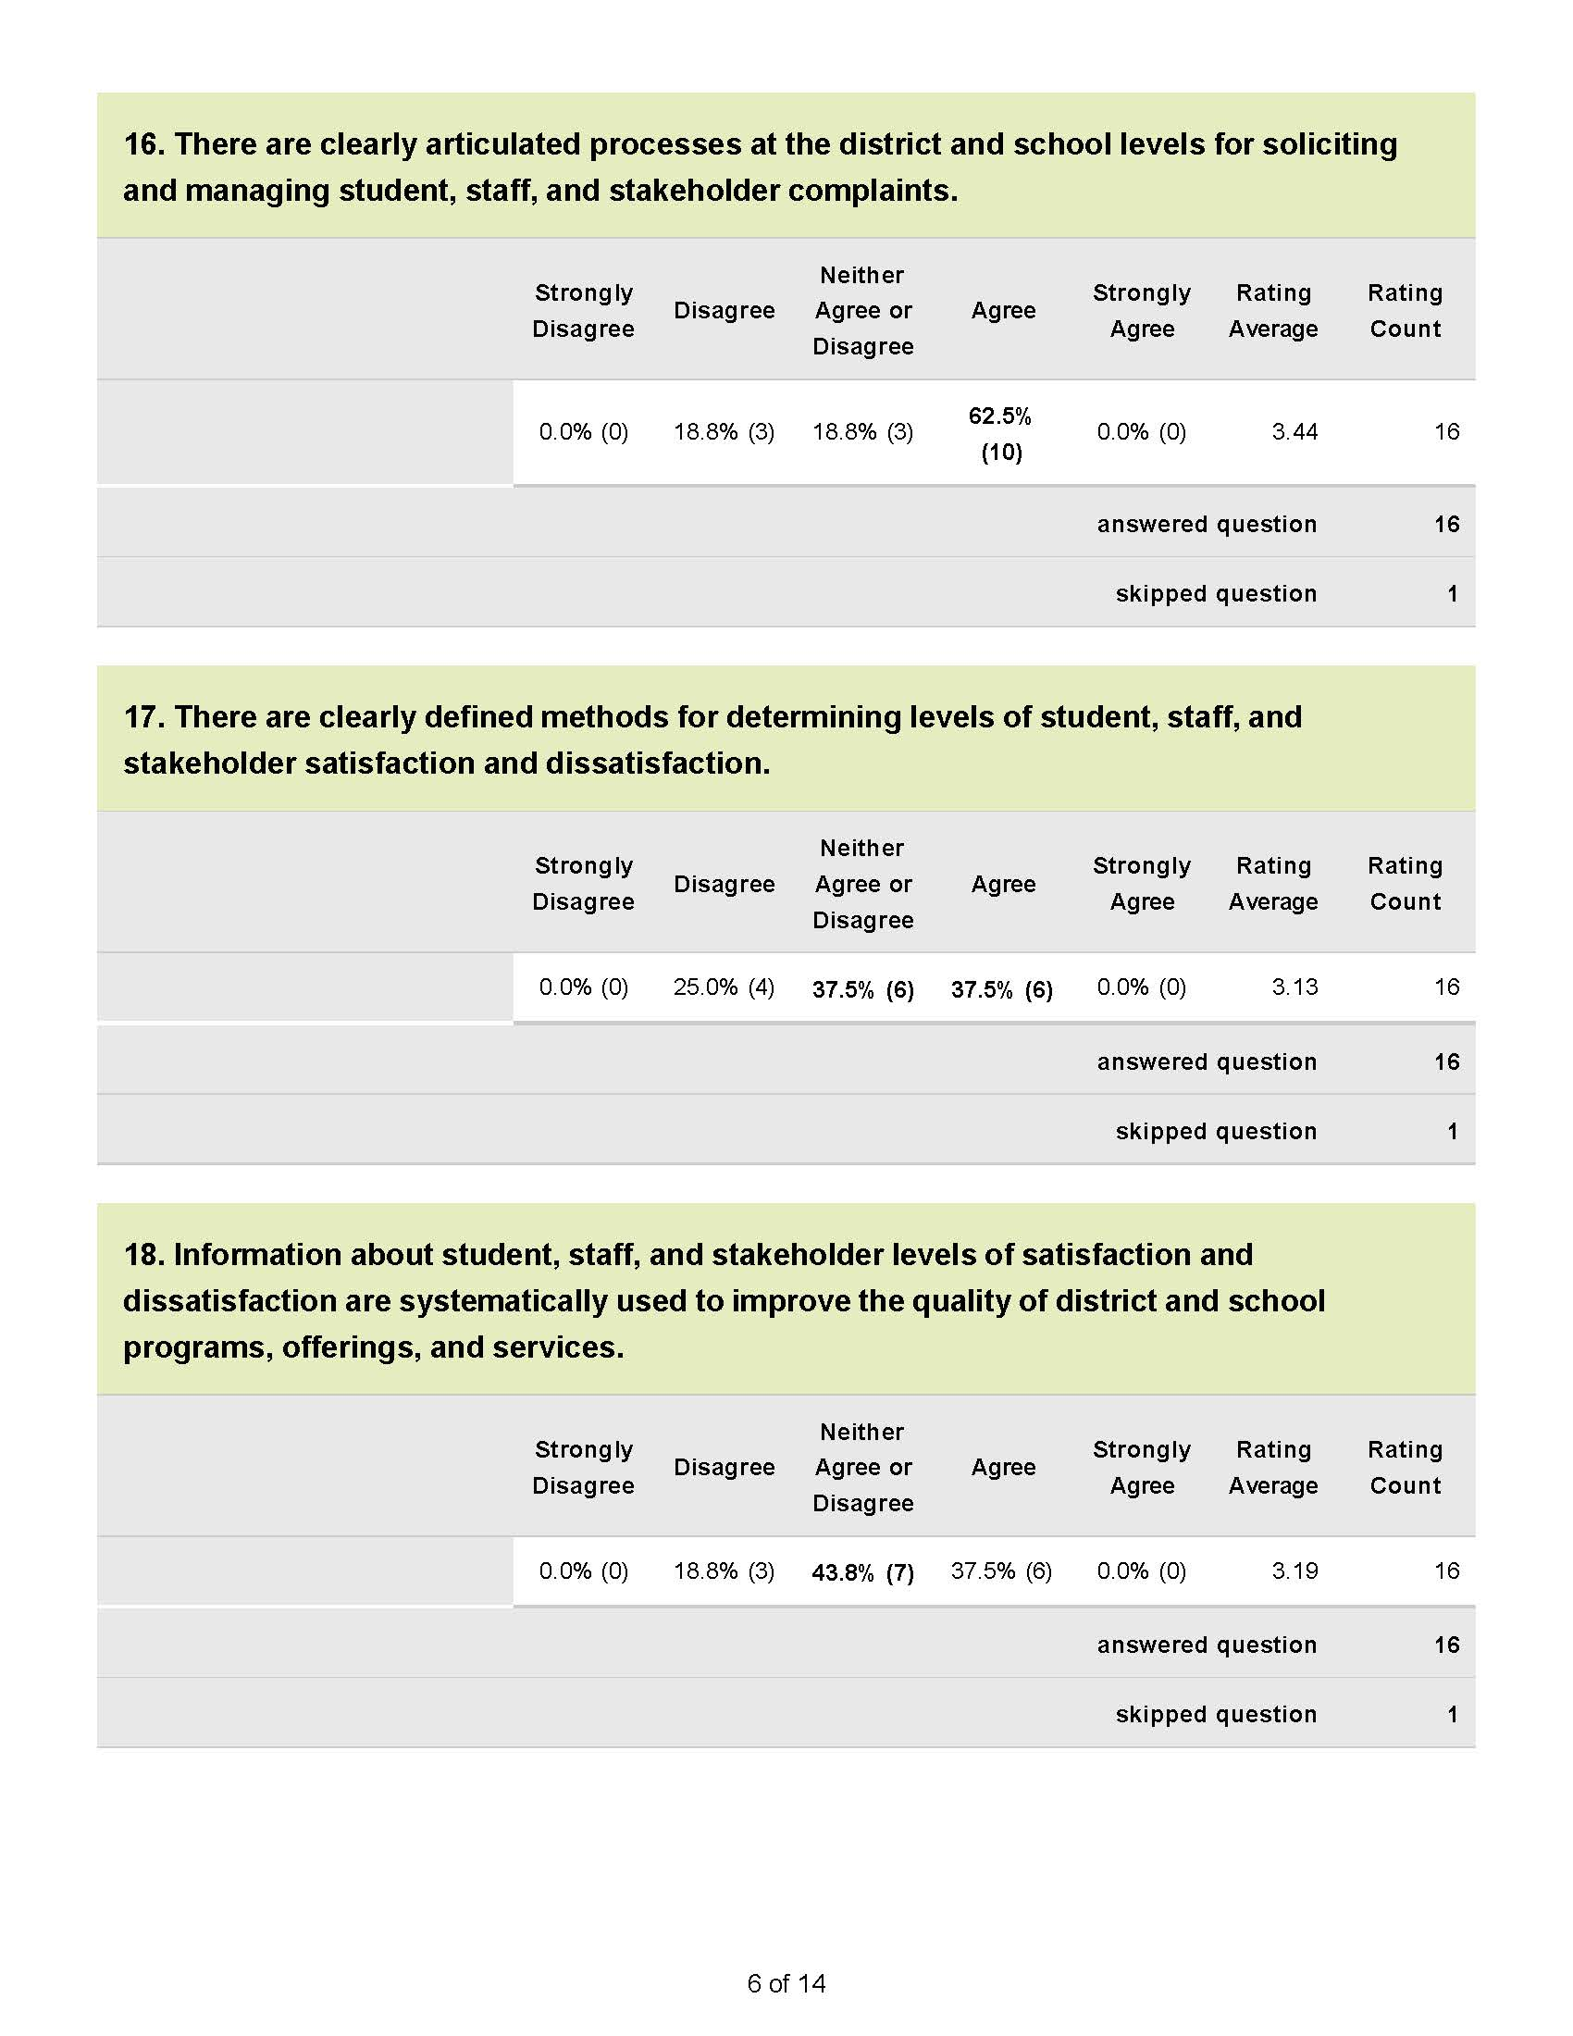

Slide 21
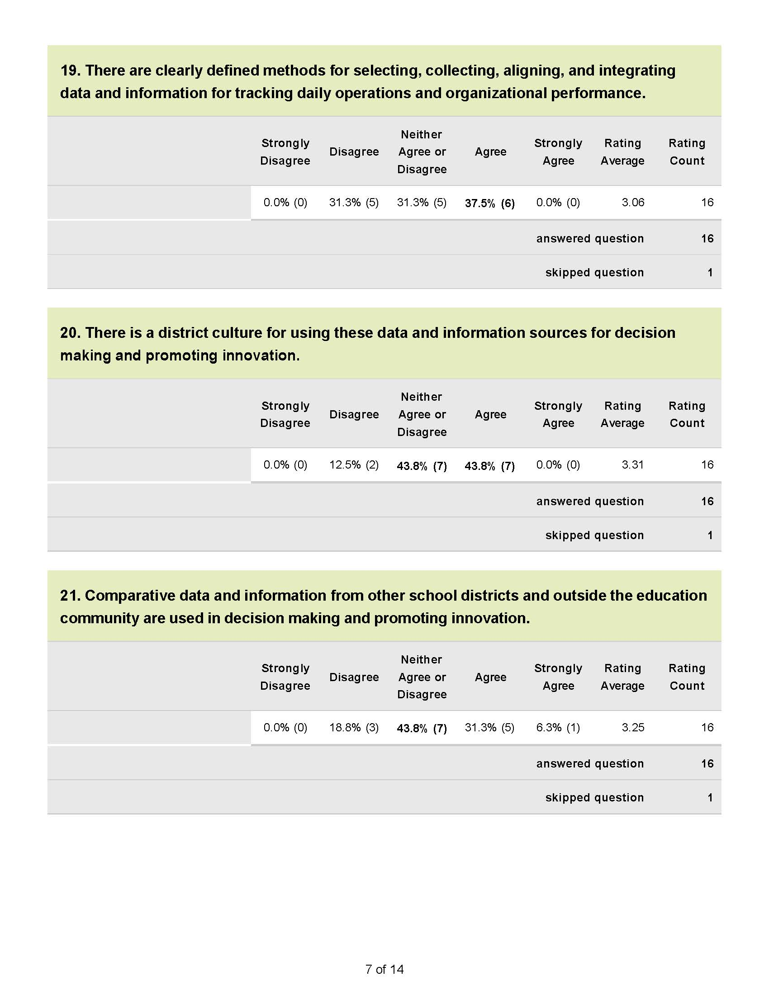

Slide 22
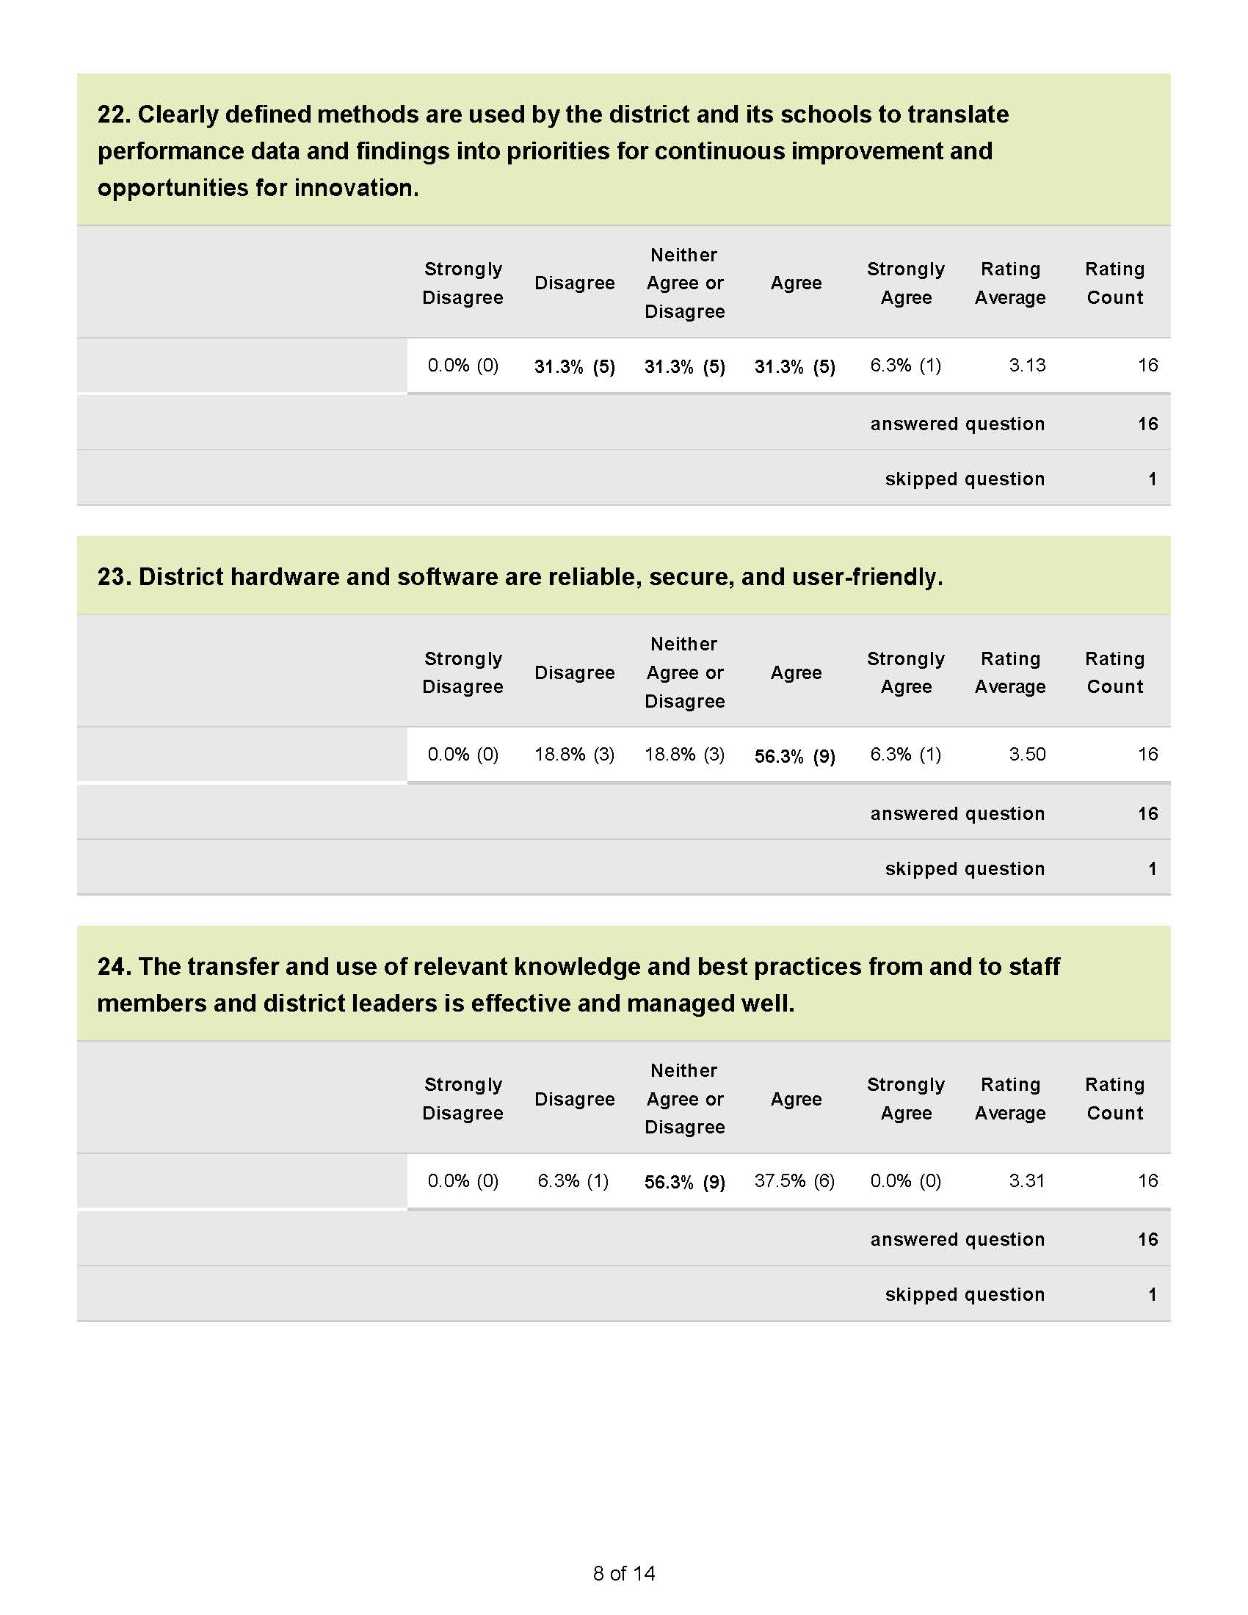

Slide 23
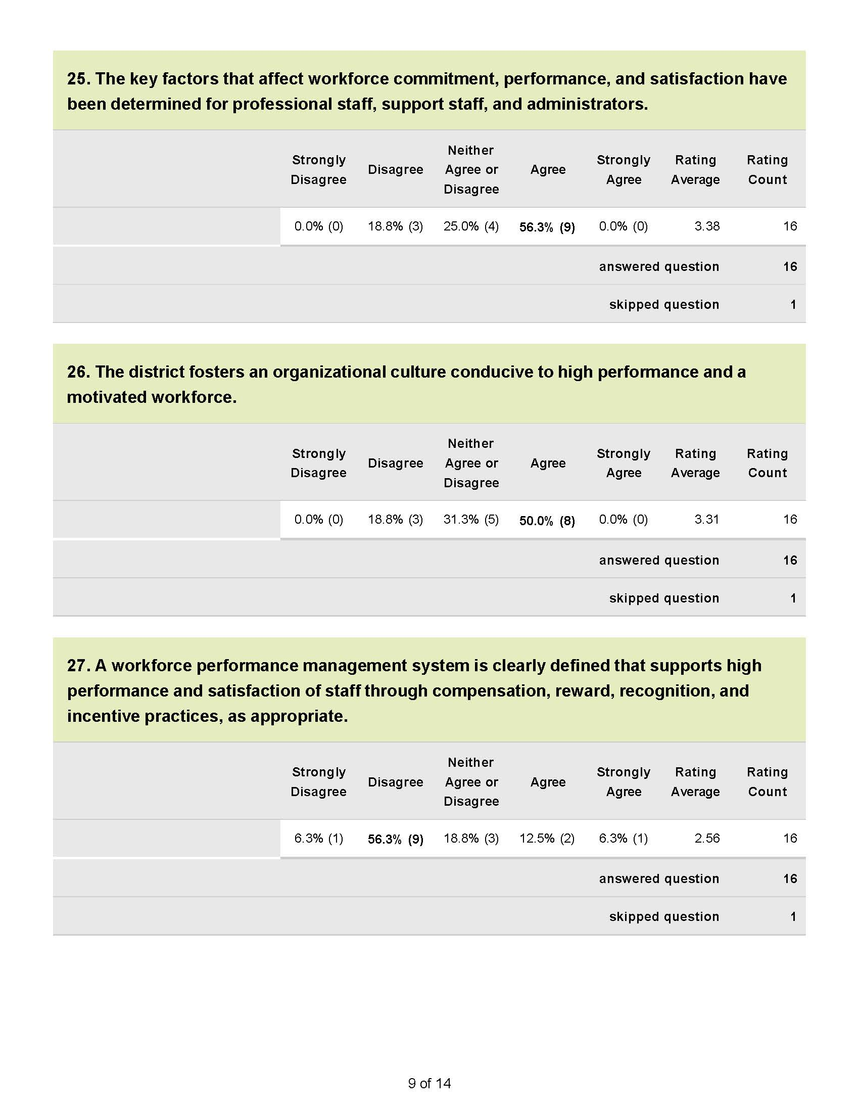

Slide 24
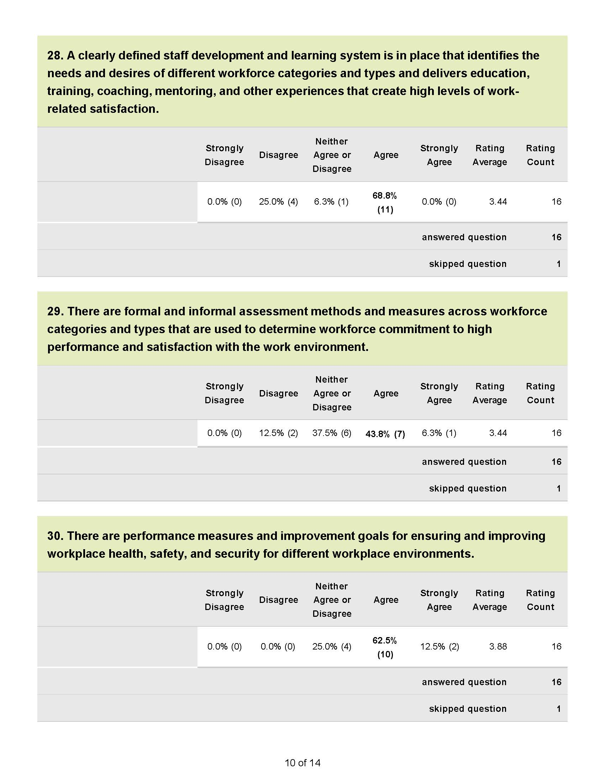

Slide 25
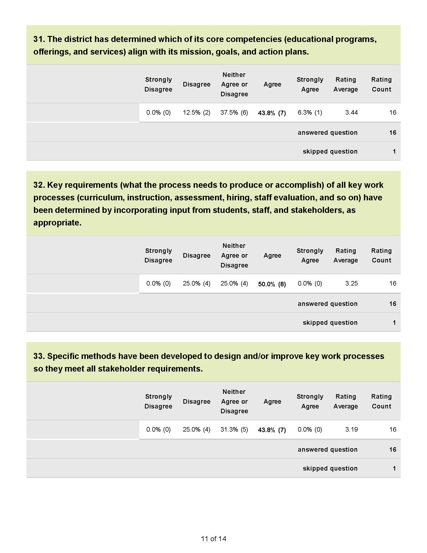

Slide 26
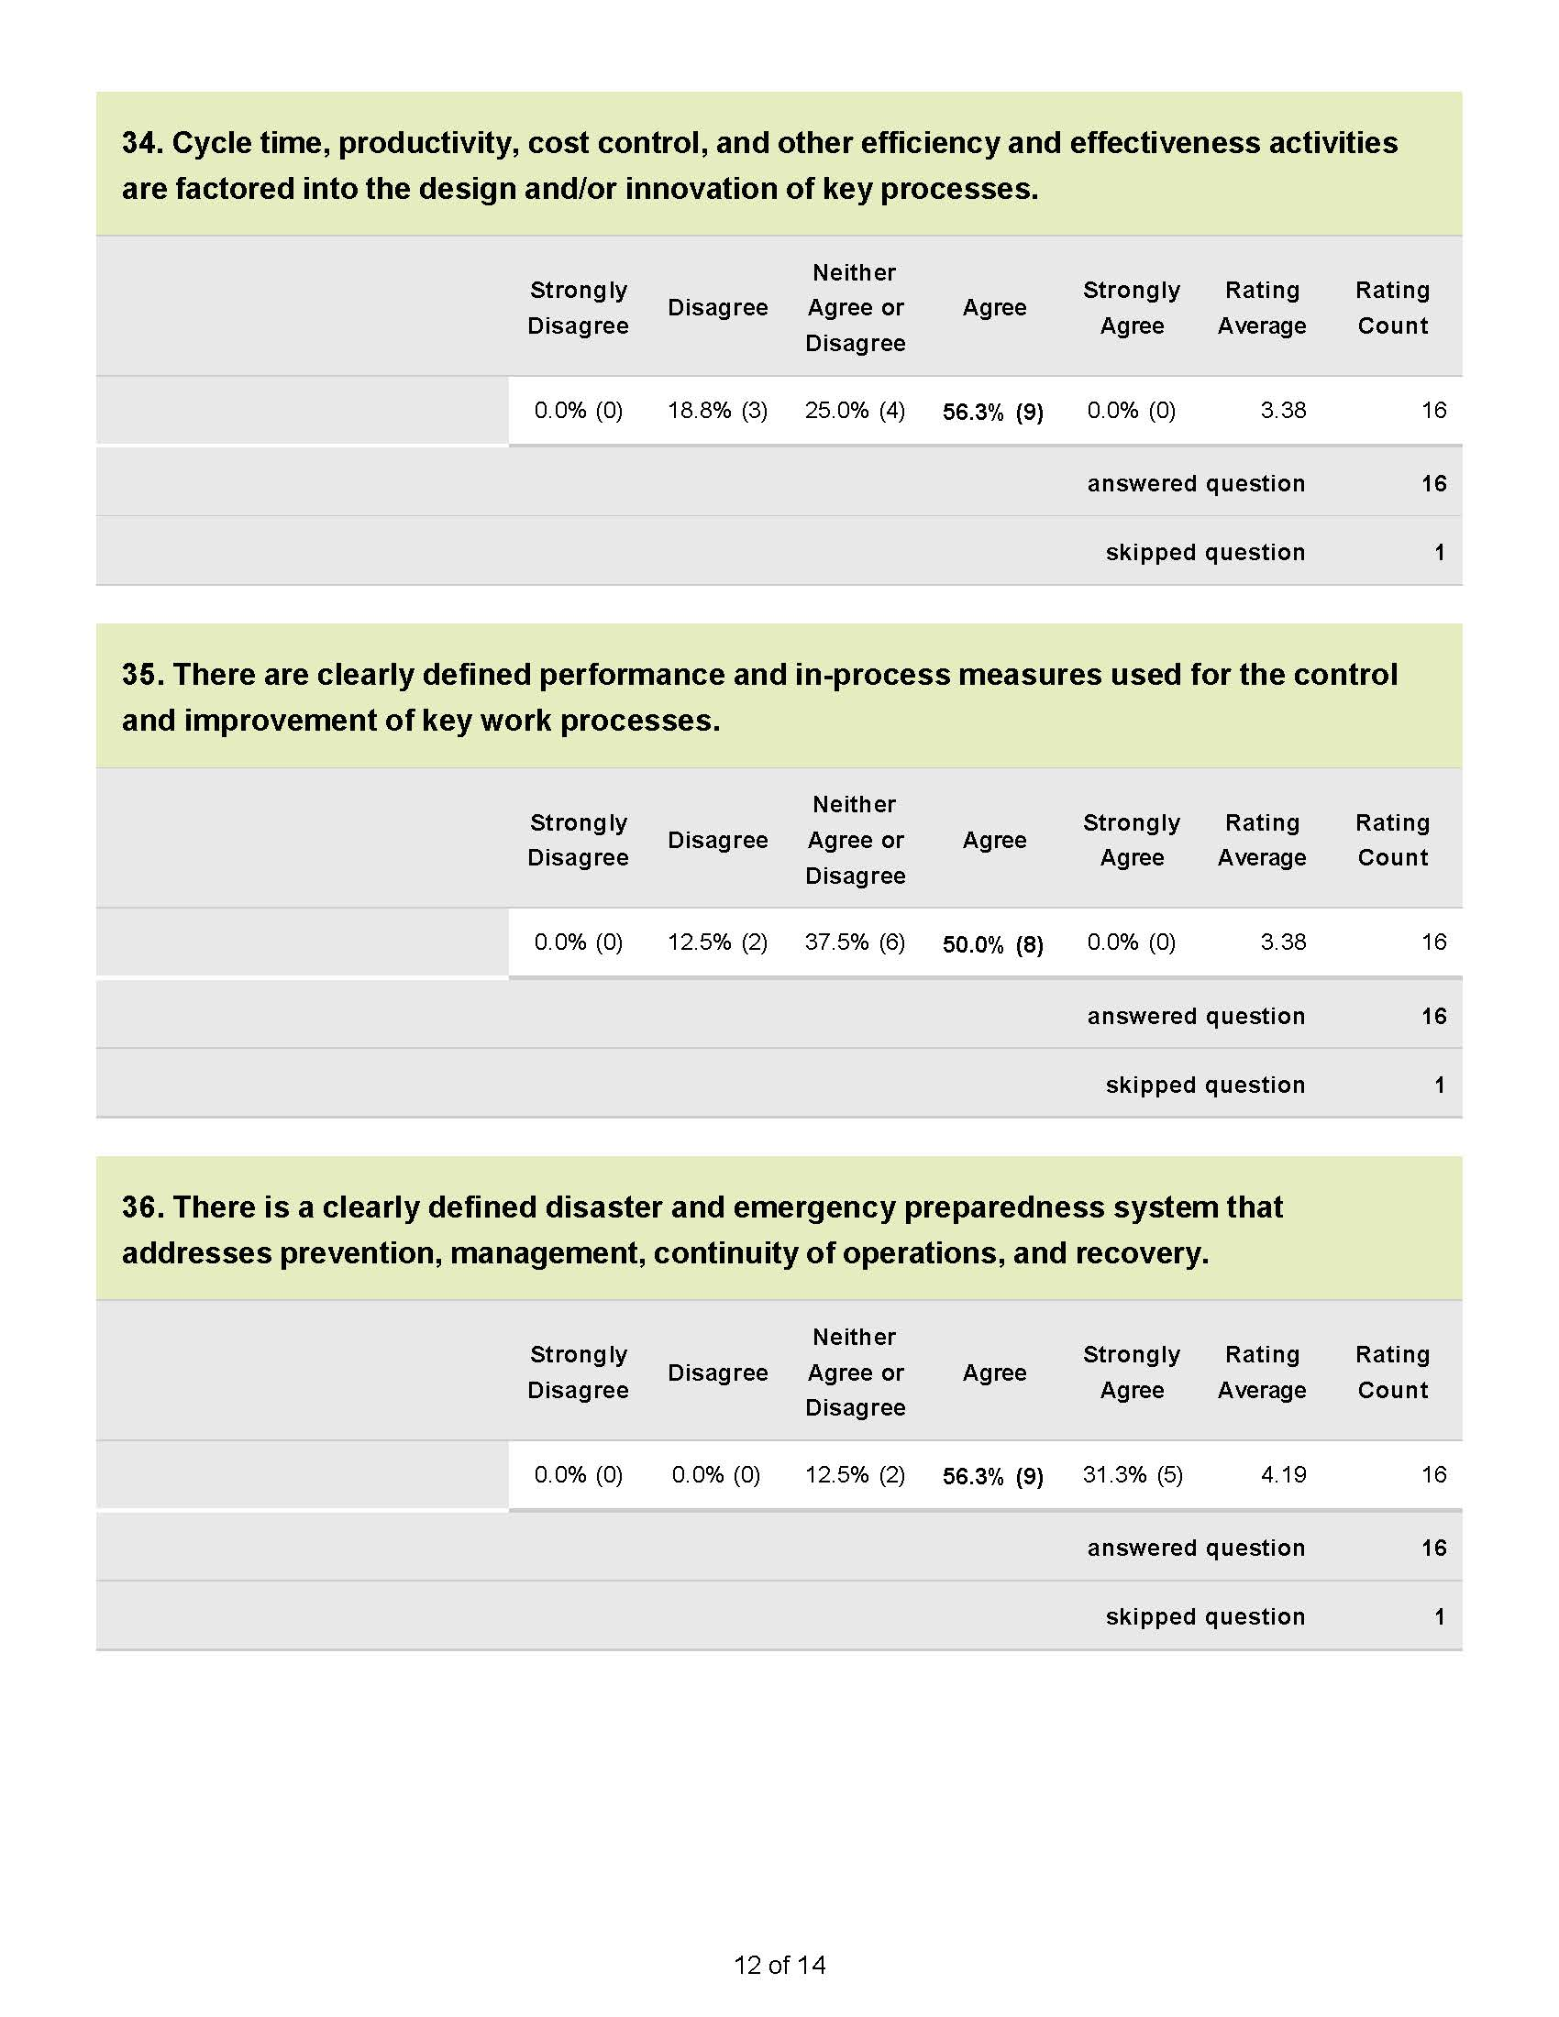

Slide 27
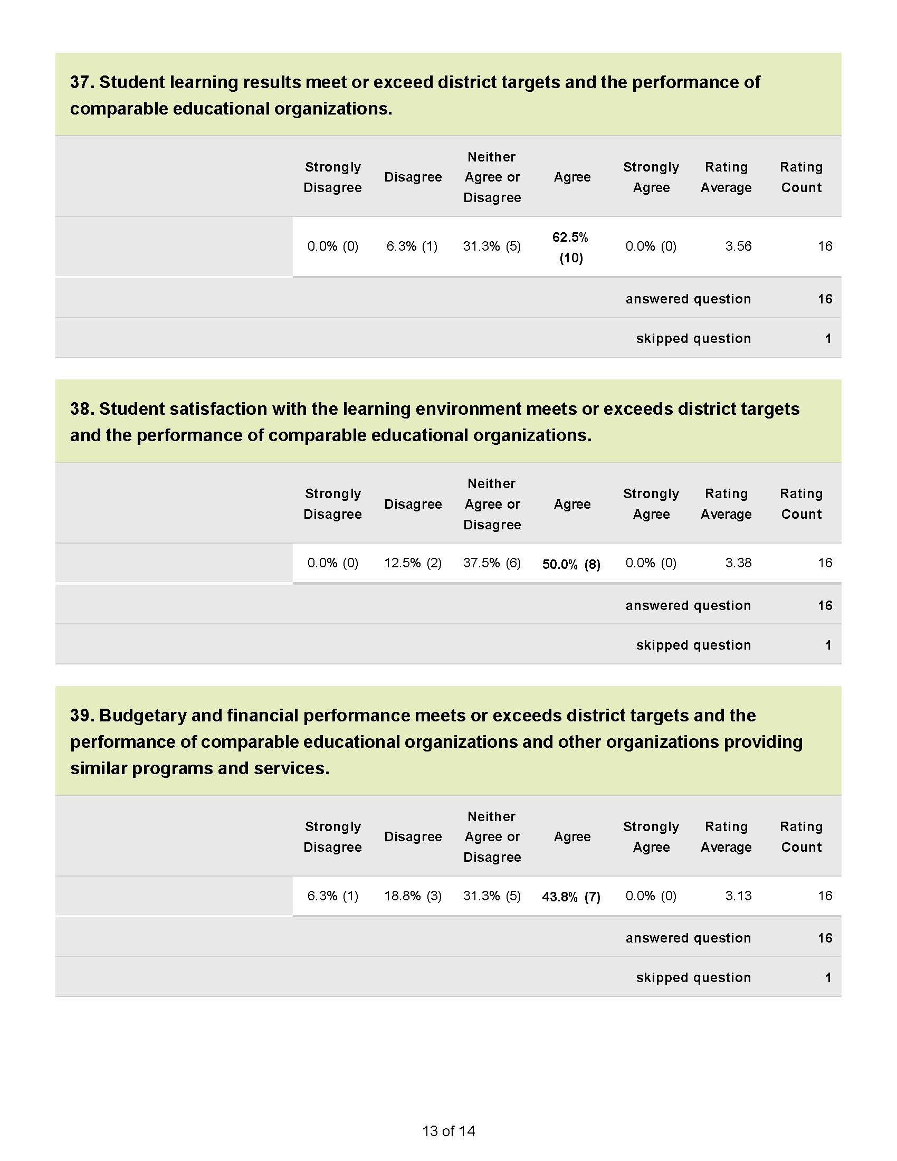

Slide 28
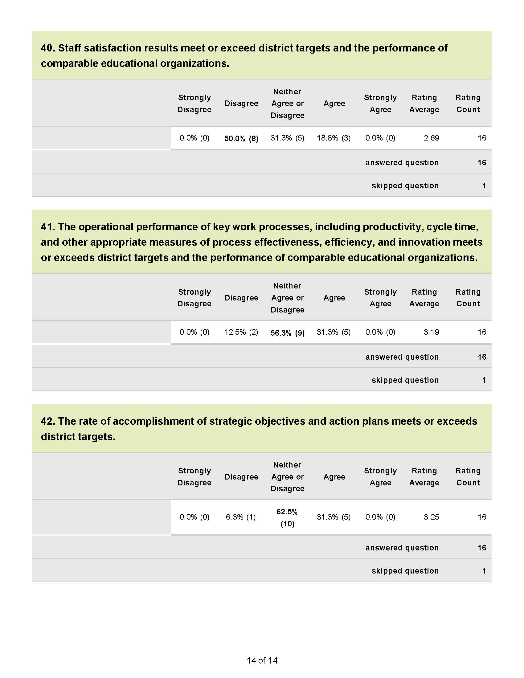

Slide 29
Community Survey Questions
Stakeholder Driven Strategic Planning
Identify your role in the community
What are the greatest challenges or issues the school district will face over the next five years…
What are the most important skills and abilities students need to know or be able to do to be prepared for a successful future?

Slide 30
Community Survey
What evidence do you use to judge the quality of education in our school district?
What should be the financial priorities be for the school district during the next five years? (select the five highest from the list)
What could the school district do that would delight you?

Slide 31
Community Survey
What information or advice would you give the strategic planning team as they make decisions about long-term priorities and goals?

Slide 32
Community Survey RESULTS
BRIEFLY review the results of the community survey.
Survey was posted online November 25th
Survey was closed the morning of January 7th
42 total responses, self identified as;
19 community, 19 parents, 17 staff, 4 students

Slide 33
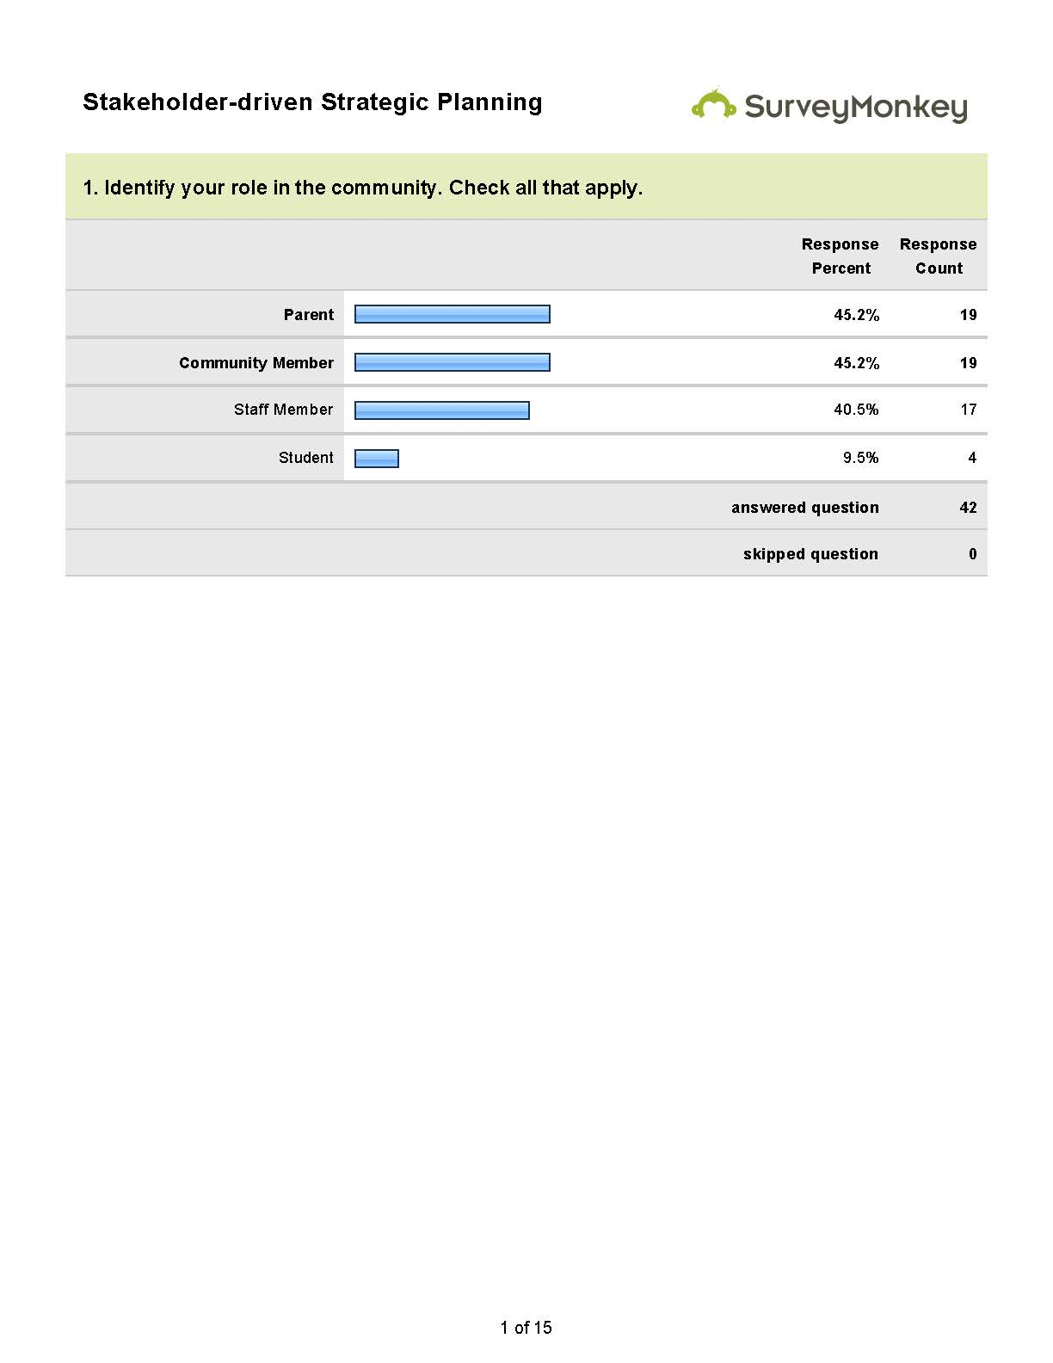

Slide 42
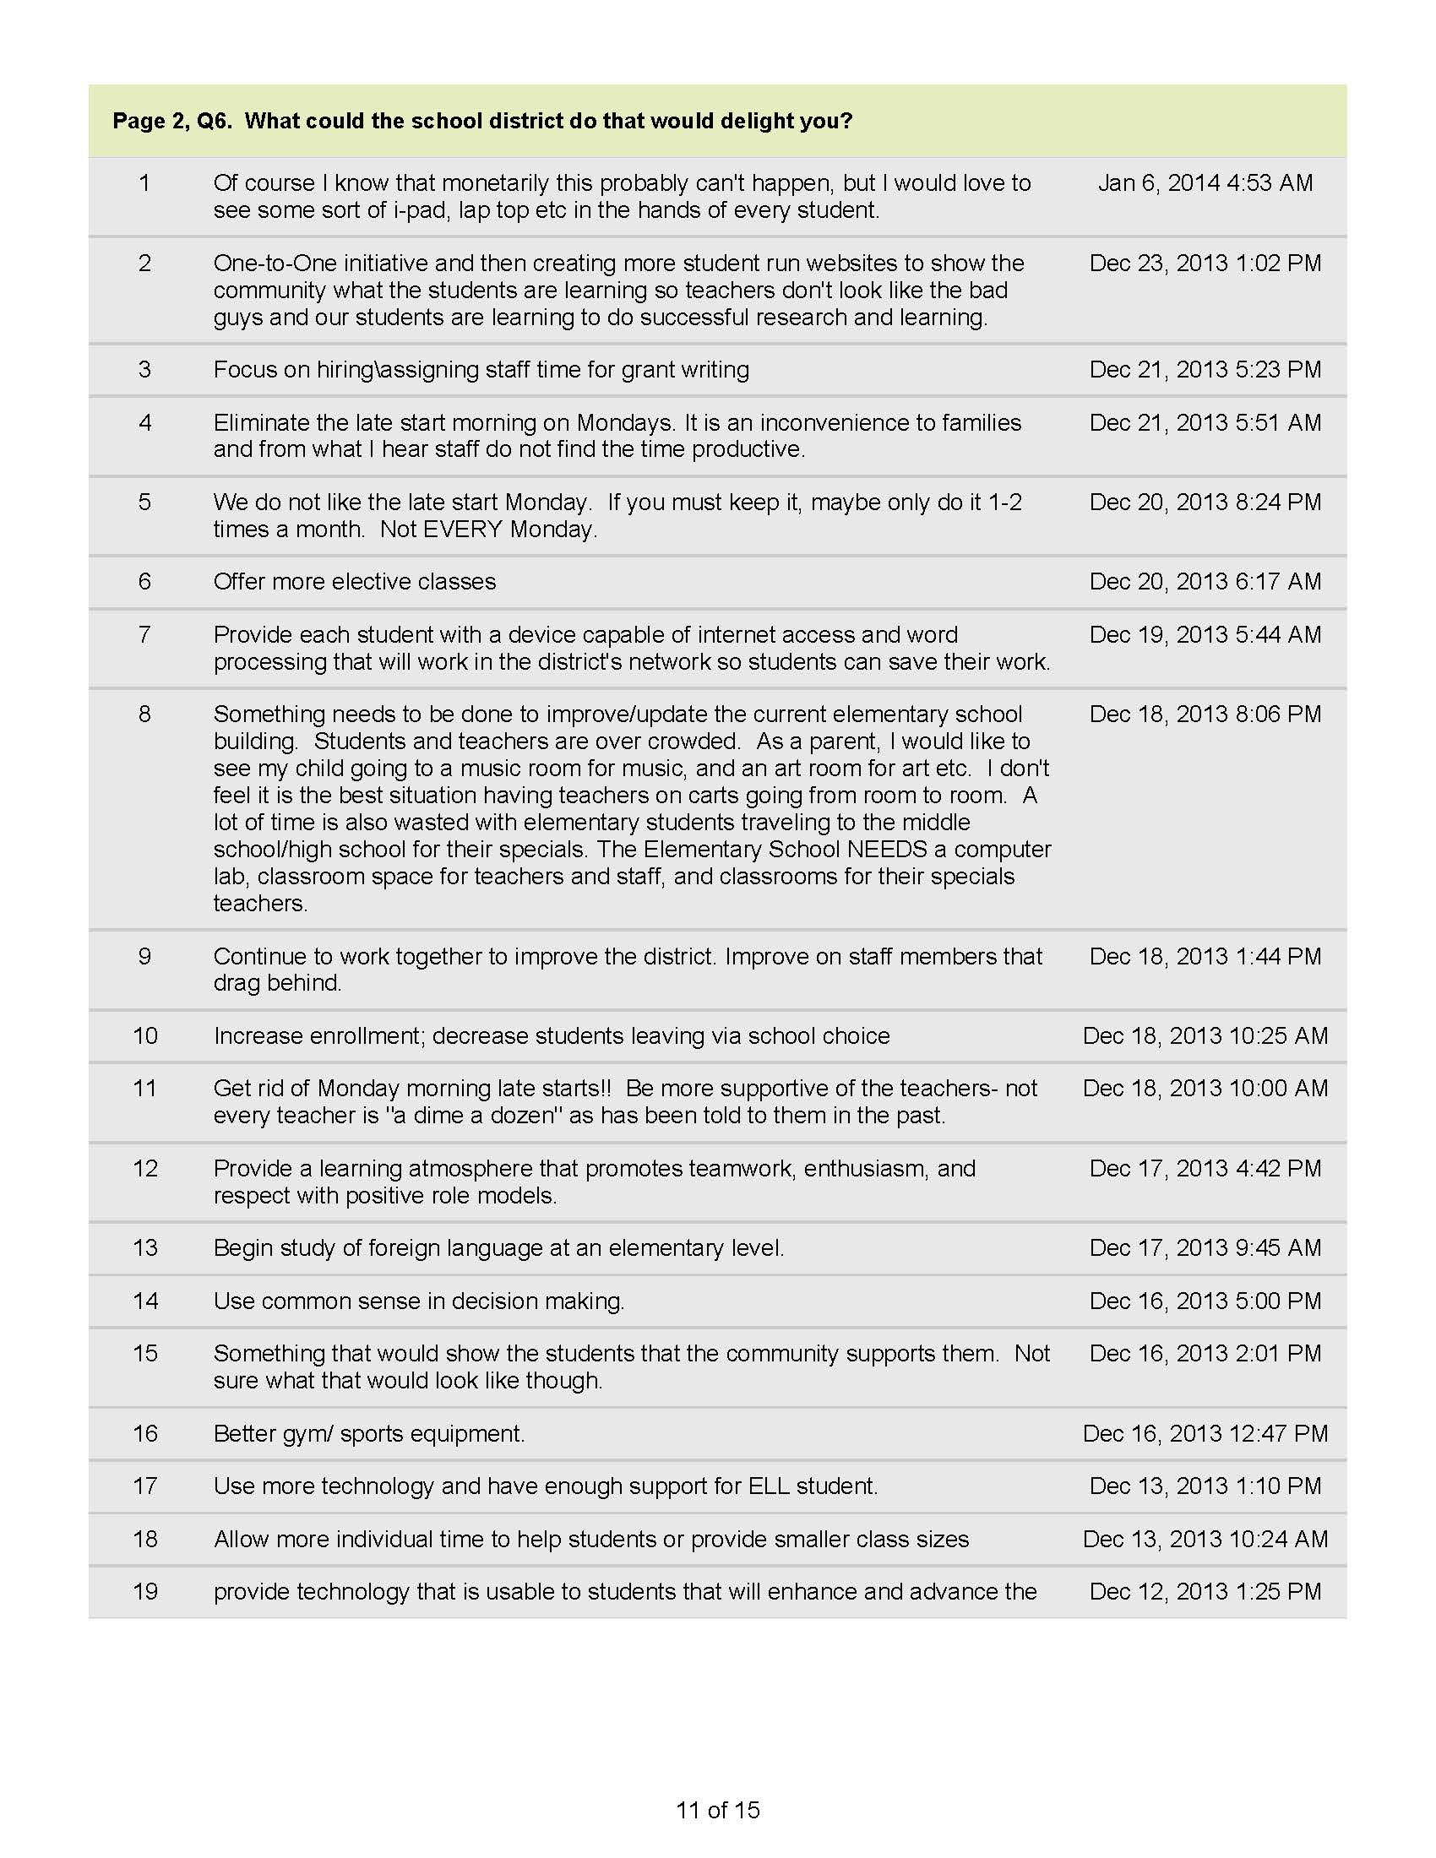

Slide 44
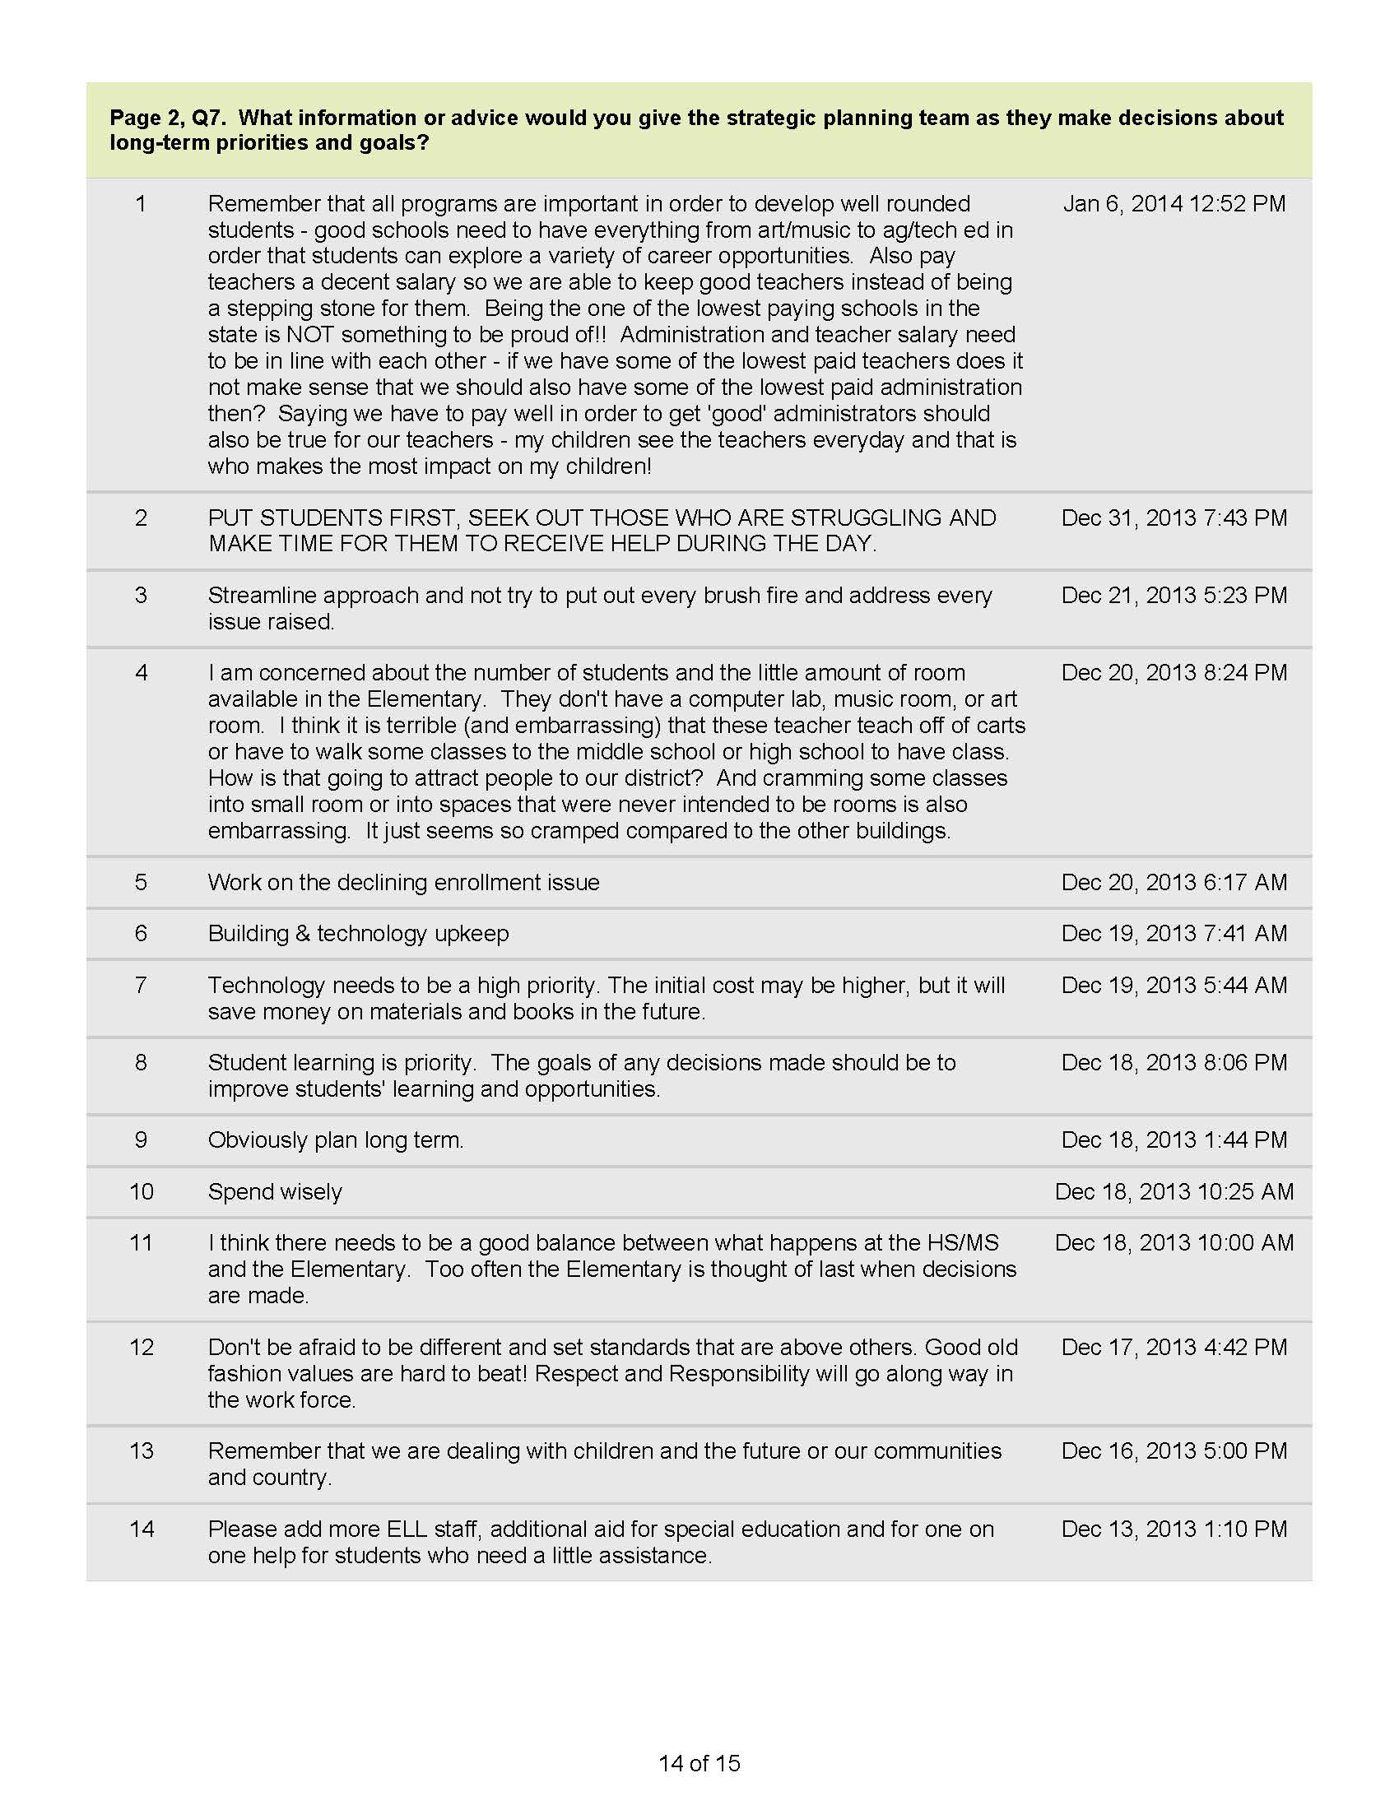

Slide 46
Thematic Analysis Activity
Activity and Sharing
About 1 hour

Slide 47
Closure
THANK YOU!
Complete the Session Feedback Forms
See you again on
February 19th @ 6:00
Middle School LMC

